Slide 1

Methods for Causal Inference in Educational Research
José Manuel Arencibia Alemán
Session 1
Photo by Riho Kroll on Unsplashed

Slide 2

Roadmap
Getting to know each other
Workshop aims and goals
Formalities & Schedule
Assignment requirements
Introduction to Causal Inference
Anatomy of Causal Relationships
Potential Outcome Framework
Photo by Taneli Lahtinen on Unsplash
Notes:
Invite them to take basic notes (they will get the slides later), because they are going to make a simple exercise later in pairs, and those notes may come Handy.
To the stdents: “Focus on formal expressions and attach meaning to them”

Slide 3

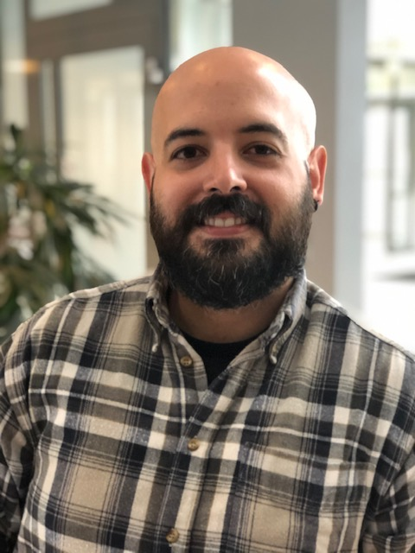
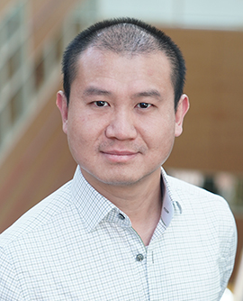
Getting to know each other
José
Tony
You?
Thesis Project?
Previous knowledge of causal inference methods/ theory?
j.m.a.aleman@cemo.uio.no
tony.tan@cemo.uio.no

Slide 4
Workshop aims
Communicating theoretical knowledge about causal and non-causal inference
Causal questions
Experimental designs
Methods
Illustrating methods for causal inference from experimental and observational data
From previous research
Exemplifying applications of the methods on R

Slide 5
Workshop learning outcomes
Deep understanding of the potential outcome framework
Broad knowledge about assumptions, prerequisites, and procedures of randomized control trials, regression models, fixed effect models, instrumental variable approaches, regression discontinuity designs and differences in differences.
Ability to critically read and interpret results of causal inference studies
Applying methodological peculiarities of the causal inference methods in own analyses
Develop Causal inference research questions and approaches

Slide 6
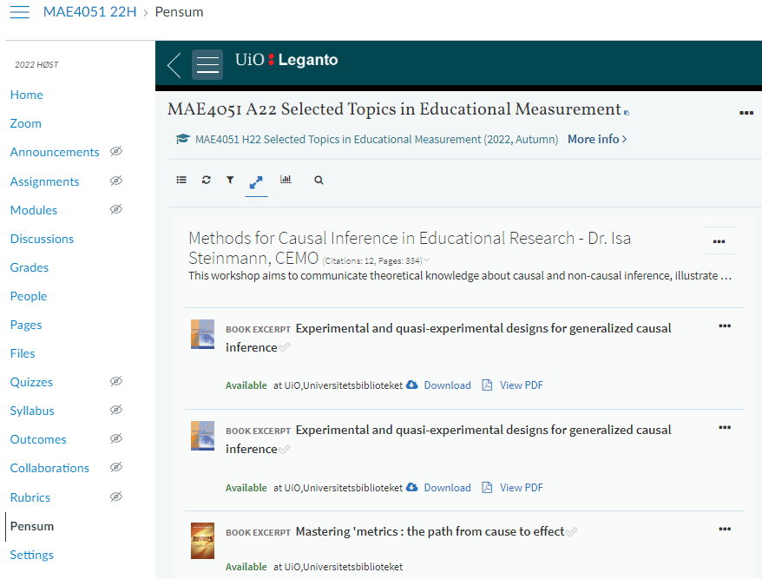

Formalities and Schedule
Required readings (in Canvas / Leganto)
Slides and Materials (in Canvas after each session)
Dates and Place (in Canvas)

Slide 7
Formalities and Schedule
1 | Introduction Time: 16 August 2022, 12:15-14:00h Main instructor: José Manuel Arencibia Alemán Required reading: Shadish, Cook, & Campbell (2002), chapter 1
2 | Designing Experiments Time: 19 August 2022, 12:15-14:00h Main instructor: Tony Tan Required reading: Shadish, Cook, & Campbell (2002), chapter 8
3 | Randomized Trials Time: 23 August 2022, 12:15-14:00h Main instructor: José Manuel Arencibia Alemán Required reading: Angrist & Pischke (2015), chapter 1
4 | Regression Models Time: 26 August 2022, 10:15-12:00h Main instructor: Tony Tan Required reading: Angrist & Pischke (2015), chapter 2
Notes:
This and the next session, very theoretical/qualitative. From the third session it becomes more methodological/quantitative

Slide 8
Formalities and Schedule
5 | Fixed Effects Time: 30 August 2022, 12:15-14:00h Main instructor: José Manuel Arencibia Alemán Required reading: Huntington-Klein (2022), chapter 16
6 | Fixed Effects / Instrumental Variables Time: 2 September 2022, 10:15-12:00h Main instructor: José Manuel Arencibia Alemán Required reading: H-K (2022), chapter 16; A. & P., chapter 3
7 | Instrumental Variables Time: 6 September 2022, 12:15-14:00h Main instructor: José Manuel Arencibia Alemán Required reading: Angrist & Pischke (2015), chapter 3
8 | Regression Discontinuity I Time: 9 September 2022, 10:15-12:00h Main instructor: José Manuel Arencibia Alemán Required reading: Angrist & Pischke (2015), chapter 4

Slide 9
Formalities and Schedule
9 | Regression Discontinuity II Time: 13 September 2022, 12:15-14:00h Main instructor: Tony Tan Required reading: Steinman & Olsen (2002)
10 | Differences-in-Differences I Time: 16 September 2022, 10:15-12:00h Main instructor: José Manuel Arencibia Alemán Required reading: Angrist & Pischke (2015), chapter 5
11 | Differences-in-Differences II Time: 20 September 2022, 12:15-14:00h Main instructor: Tony Tan Required reading: Strello, Strietholdt, Steinmann & Siepmann (2021)
12 | Lessons Learned Time: 23 September 2022, 10:15-12:00h Main instructor: José Manuel Arencibia Alemán Required reading: Rutkowski & Delandshere (2016)

Slide 10
Assignment Requirements

Slide 11

Notes:
Questions so far?

Slide 12
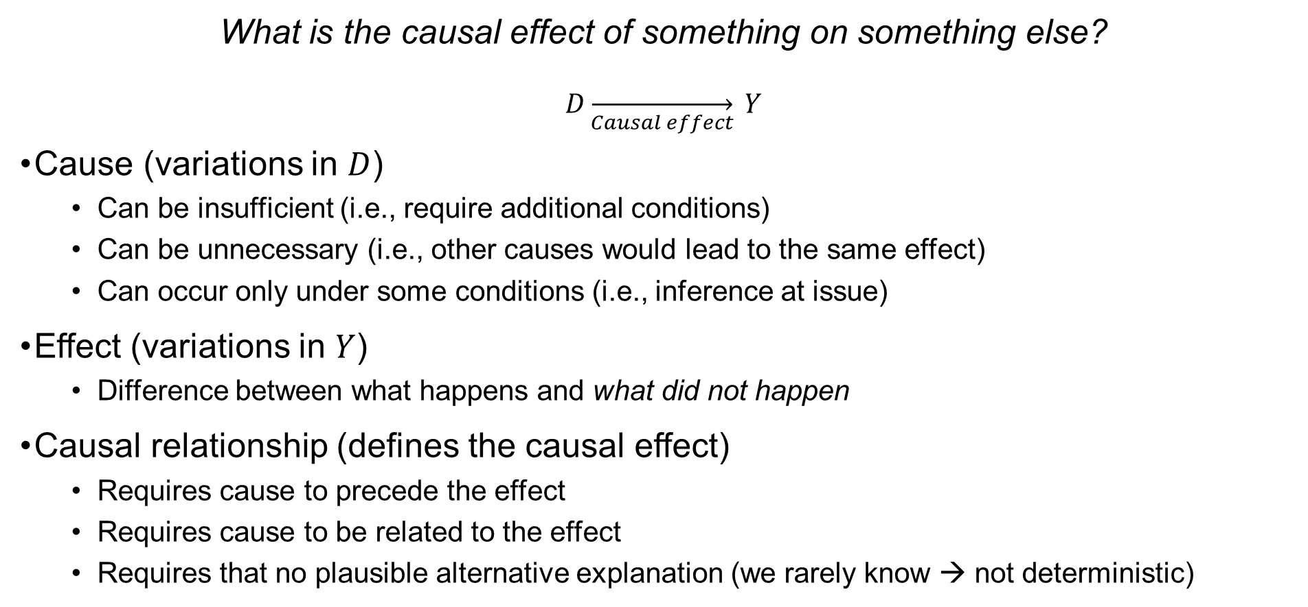
Introduction to Causal Inference
What is the causal effect of something on something else?
$$D\overset{→}{Causal effect} Y$$
Cause (variations in $D$)
Can be insufficient (i.e., require additional conditions)
Can be unnecessary (i.e., other causes would lead to the same effect)
Can occur only under some conditions (i.e., inference at issue)
Effect (variations in $Y$)
Difference between what happens and what did not happen
Causal relationship (defines the causal effect)
Requires cause to precede the effect
Requires cause to be related to the effect
Requires that no plausible alternative explanation (we rarely know → not deterministic)
Campfire example
Notes:
Many theoretical and philosophical underpinnings difficulting to give a right answer (although wrong answers pop up).
Often times, causal effects are equated causal relationships: That is, variation in something else (outcome) due to something (treatment)
In order to not give wrong answers, we need to understand what are causes and effects.
Effect: that which had its beginning from some other thing (cause)

Slide 13

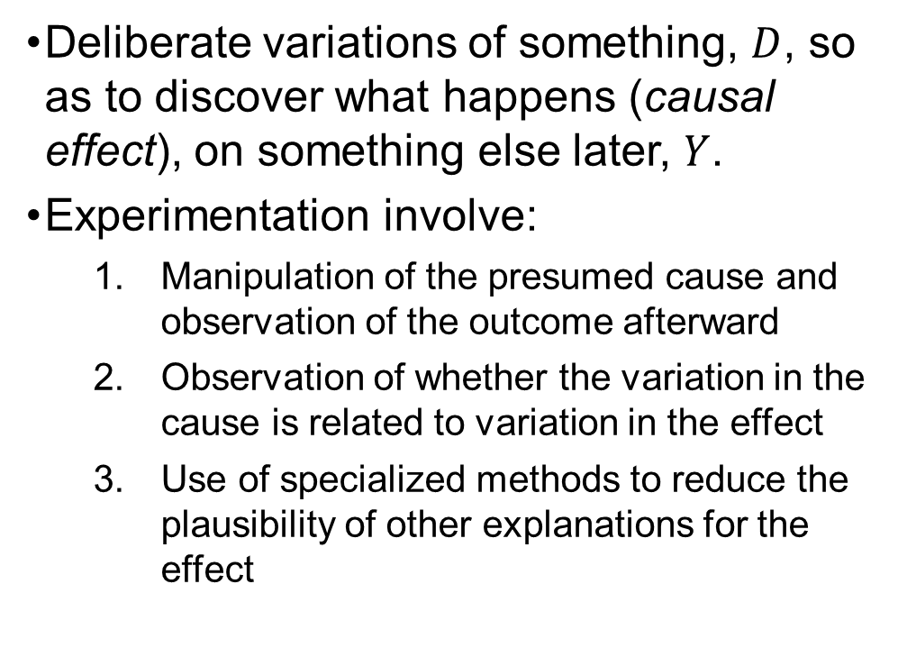
Introduction to Causal Inference
What is an experiment?
Deliberate variations of something, $D$, so as to discover what happens (causal effect), on something else later, $Y$.
Experimentation involve:
Manipulation of the presumed cause and observation of the outcome afterward
Observation of whether the variation in the cause is related to variation in the effect
Use of specialized methods to reduce the plausibility of other explanations for the effect
Photo by Akram Huseyn on Unsplash

Slide 14
Introduction to Causal Inference
What is an experiment?
Causal relationship (defines the causal effect)
Requires cause to precede the effect
Requires cause to be related to the effect
Requires that no plausible alternative explanation (we rarely know → not deterministic)
Deliberate variations of something, $D$, so as to discover what happens (causal effect), on something else later, $Y$.
Experimentation involve:
Manipulation of the presumed cause and observation of the outcome afterward
Observation of whether the variation in the cause is related to variation in the effect
Use of specialized methods to reduce the plausibility of other explanations for the effect

Slide 15
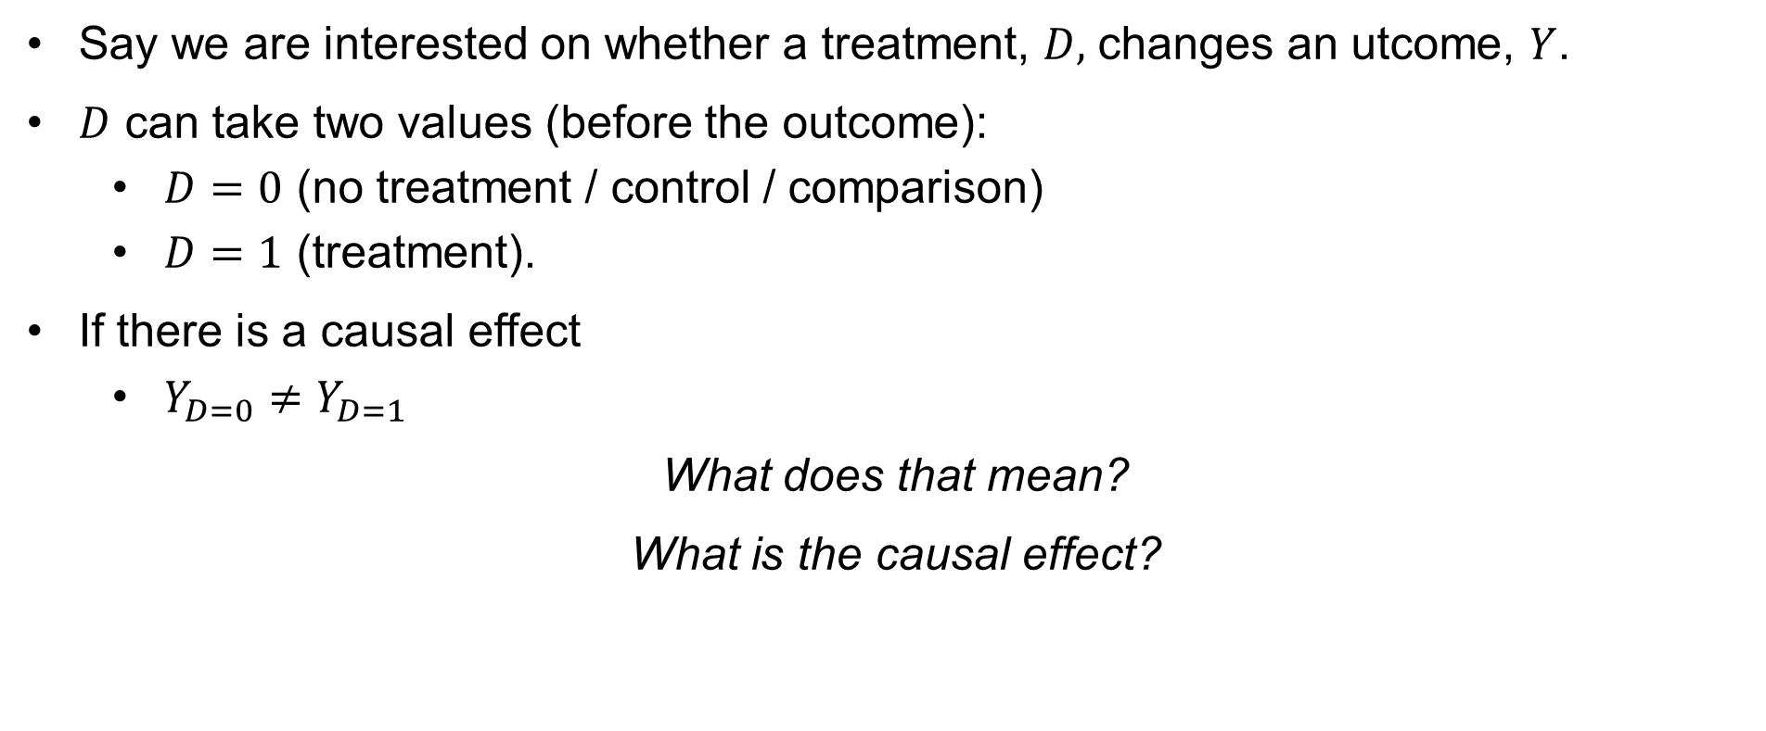
Rubin’s Potential Outcome Framework
Say we are interested on whether a treatment, $D,$ changes an utcome, $Y$.
$D$ can take two values (before the outcome):
$D=0$ (no treatment / control / comparison)
$D=1$ (treatment).
If there is a causal effect
$Y_{D=0}≠Y_{D=1}$
What does that mean?
What is the causal effect?

Slide 16
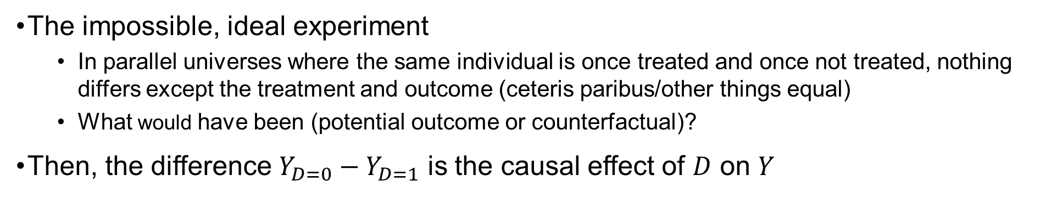
Rubin’s potential outcome framework
with D=0
and Y_{D=0}
with D=1
and Y_{D=1}
The impossible, ideal experiment
In parallel universes where the same individual is once treated and once not treated, nothing differs except the treatment and outcome (ceteris paribus/other things equal)
What would have been (potential outcome or counterfactual)?
Then, the difference $Y_{D=0}−Y_{D=1}$ is the causal effect of $D$ on $Y$
Rubin, 1974

Slide 17
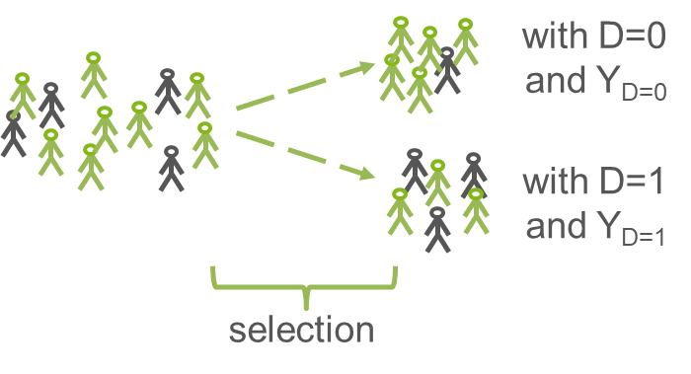
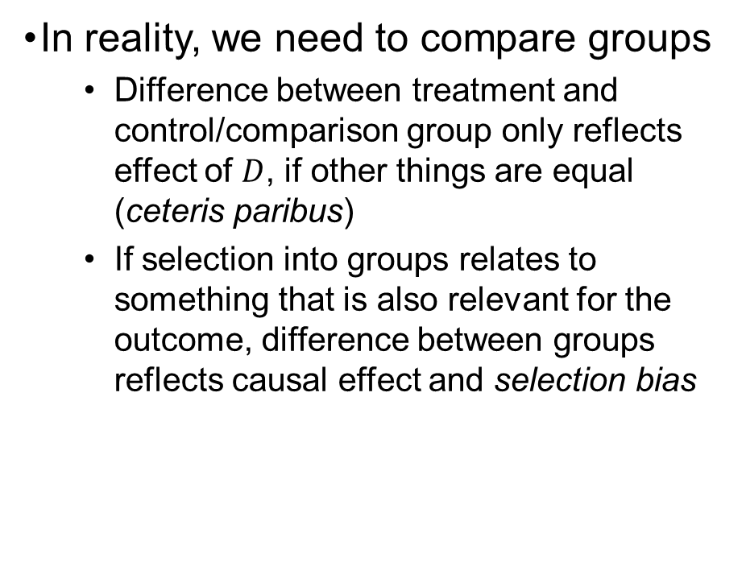
Rubin’s potential outcome framework
In reality, we need to compare groups
Difference between treatment and control/comparison group only reflects effect of $D$, if other things are equal (ceteris paribus)
If selection into groups relates to something that is also relevant for the outcome, difference between groups reflects causal effect and selection bias
Rubin, 1974

Slide 18


Rubin’s potential outcome framework
selection
bias!
Example:
Negative correlation between private tutoring and mathematics achievement

Slide 19
Notes:
Questions so far?

Slide 20
Correlation ≠ Causation (!)
Why does correlation not prove causation?
maybe we don’t know which variable came first (e.g., reverse causation)
maybe, there is no true association, at all (e.g., spurious correlation)
maybe, there are other explanations (e.g., third-variable effect, confounding, selection bias)
D
Y
D
Y
D
Y
Z

Slide 21


Summing up

Slide 22
Take away messages
Causal Inference is possible if
Plausible causal mechanism
Treatment before outcome
Comparison with counterfactual
Ceteris paribus
Very good counterfactuals and ceteris paribus are difficult to establish
Multiple issues prohibit causal inferences, for example:
Selection bias
Reverse causation
Third-variable bias (or confounding effects)

Slide 23
Formalities and Schedule
1 | Introduction Time: 16 August 2022, 12:15-14:00h Main instructor: José Manuel Arencibia Alemán Required reading: Shadish, Cook, & Campbell (2002), chapter 1
2 | Designing Experiments Time: 19 August 2022, 12:15-14:00h Main instructor: Tony Tan Required reading: Shadish, Cook, & Campbell (2002), chapter 8
3 | Randomized Trials Time: 23 August 2022, 12:15-14:00h Main instructor: José Manuel Arencibia Alemán Required reading: Angrist & Pischke (2015), chapter 1
4 | Regression Models Time: 26 August 2022, 10:15-12:00h Main instructor: Tony Tan Required reading: Angrist & Pischke (2015), chapter 2
Notes:
This and the next session, very theoretical/qualitative. From the third session it becomes more methodological/quantitative

Slide 24
References
Angrist, J. & Pischke, J.-S. (2015). Mastering `Metrics: The Path from Cause to Effect. Princeton University Press
Rubin, D. B. (1974). Estimating causal effects of treatments in randomized and nonrandomized studies. Journal of Educational Psychology, 66(5), 688–701
Shadish, W. R., Cook, T. D., & Campbell, D. T. (2002). Experimental and quasi-experimental designs for generalized causal inference. Mifflin and Company

